Slide 1
ICS 141 – Programming With Objects
Lecture 2 – Robert Jahn
Based on the slides of Dr. Daniel Liang

Slide 2
Schedule
Announcements/Reminders 6:00 – 6:10
Quiz #1 6:10 – 6:30
Types of Errors 6:30 – 6:35
Conditionals 6:35 – 7:00
Exercise 2(a) + Break 7:00 – 7:15
Loops 7:15 – 7:40
Exercise 2(b) 7:40 – 7:50
Casting – Numerical Values 7:50 – 8:00
Assignment #2 8:00 – 8:05
Lab #2 8:05 – 8:30

Slide 3
Quiz #1

Slide 4
Programming Errors
Syntax Errors
Detected by the compiler
Runtime Errors
Causes the program to abort
Logic Errors
Produces incorrect result

Slide 5
Syntax Errors
public class ShowSyntaxErrors {
public static main(String[] args) {
System.out.println("Welcome to Java);
}
}

Slide 6
Runtime Errors
public class ShowRuntimeErrors {
public static void main(String[] args) {
System.out.println(1 / 0);
}
}

Slide 7
Logic Errors
public class ShowLogicErrors {
public static void main(String[] args) {
System.out.println("Celsius 35 is Fahrenheit degree ");
System.out.println((9 / 5) * 35 + 32);
}
}

Slide 8
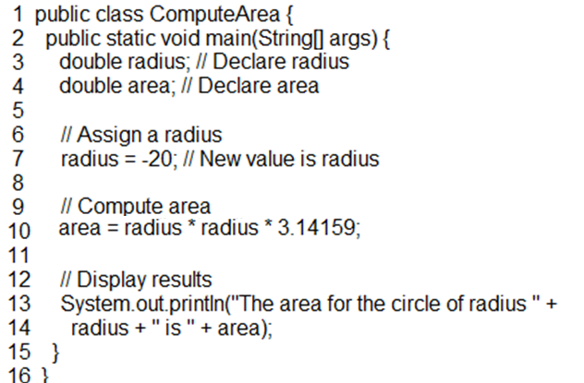
Motivations
If you assigned a negative value for radius in Listing 2.1, ComputeArea.java, the program would print an invalid result. If the radius is negative, you don't want the program to compute the area. How can you deal with this situation?

Slide 9
The boolean Type and Operators
Often in a program you need to compare two values, such as whether i is greater than j. Java provides six comparison operators (also known as relational operators) that can be used to compare two values. The result of the comparison is a boolean value: true or false.
boolean b = (1 > 2);

Slide 10
Comparison Operators

Slide 11
Conditional Operators
Java also provides conditional operators.
&&
A pair of ampersands represents ‘and’.
||
A pair of lines represent ‘or’.
These lines can be found with the shift-\ key.

Slide 12
Conditional Operators
int x = 5;
int y = 4;
if ( (x == 5) && (y == 5) ) returns false
if ( (x == 5) || (y == 5) ) returns true

Slide 13
One-way if Statements
if (radius >= 0) {
area = radius * radius * PI;
System.out.println("The area for the circle of radius "
+ radius + " is " + area);
}
if (boolean-expression) {
statement(s);
}

Slide 14
Note

Slide 15
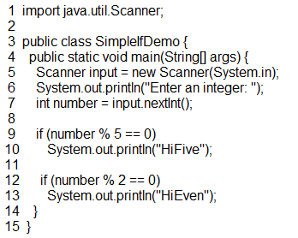
Simple if Demo
Write a program that prompts the user to enter an integer. If the number is a multiple of 5, print HiFive. If the number is divisible by 2, print HiEven.

Slide 16
The Two-way if Statement
if (boolean-expression) {
statement(s)-for-the-true-case;
}
else {
statement(s)-for-the-false-case;
}

Slide 17
if-else Example
if (radius >= 0) {
area = radius * radius * 3.14159;
System.out.println("The area for the circle of radius" + radius + " is " + area);
}
else {
System.out.println("Negative input");
}

Slide 18
Multiple Alternative if Statements

Slide 19
Multi-Way if-else Statements

Slide 20
Trace if-else statement
animation
Suppose score is 70.0
The condition is false
if (score >= 90.0)
grade = 'A';
else if (score >= 80.0)
grade = 'B';
else if (score >= 70.0)
grade = 'C';
else if (score >= 60.0)
grade = 'D';
else
grade = 'F';

Slide 21
Trace if-else statement
animation
Suppose score is 70.0
The condition is false
if (score >= 90.0)
grade = 'A';
else if (score >= 80.0)
grade = 'B';
else if (score >= 70.0)
grade = 'C';
else if (score >= 60.0)
grade = 'D';
else
grade = 'F';

Slide 22
Trace if-else statement
animation
Suppose score is 70.0
The condition is true
if (score >= 90.0)
grade = 'A';
else if (score >= 80.0)
grade = 'B';
else if (score >= 70.0)
grade = 'C';
else if (score >= 60.0)
grade = 'D';
else
grade = 'F';

Slide 23
Trace if-else statement
animation
Suppose score is 70.0
grade is C
if (score >= 90.0)
grade = 'A';
else if (score >= 80.0)
grade = 'B';
else if (score >= 70.0)
grade = 'C';
else if (score >= 60.0)
grade = 'D';
else
grade = 'F';

Slide 24
Trace if-else statement
animation
Suppose score is 70.0
Exit the if statement
if (score >= 90.0)
grade = 'A';
else if (score >= 80.0)
grade = 'B';
else if (score >= 70.0)
grade = 'C';
else if (score >= 60.0)
grade = 'D';
else
grade = 'F';

Slide 25
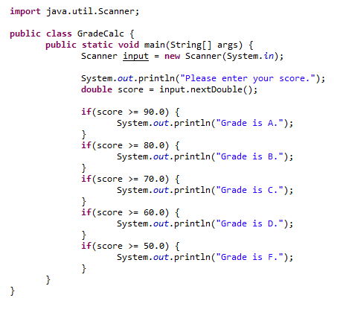
Example

Slide 26
Note
The else clause matches the most recent if clause in the same block.

Slide 27
Note, cont.
Nothing is printed from the preceding statement. To force the else clause to match the first if clause, you must add a pair of braces:
int i = 1;
int j = 2;
int k = 3;
if (i > j) {
if (i > k)
System.out.println("A");
}
else
System.out.println("B");
This statement prints B.

Slide 28
Common Errors
Adding a semicolon at the end of an if clause is a common mistake.
if (radius >= 0);
{
area = radius*radius*PI;
System.out.println(
"The area for the circle of radius " +
radius + " is " + area);
}
This mistake is hard to find, because it is not a compilation error or a runtime error, it is a logic error.
This error often occurs when you use the next-line block style.
Wrong

Slide 29
CAUTION

Slide 30
Exercise 2(a)

Slide 31
Loops
In java, we have access to three different loop mechanisms
For
While
Do-while
As we’ll see, these are all useful in different situations. However, for the most part, they are interchangeable.

Slide 32
Motivations
Suppose that you need to print a string (e.g., "Welcome to Java!") a hundred times. It would be tedious to have to write the following statement a hundred times:
System.out.println("Welcome to Java!");
So, how do you solve this problem?

Slide 33
Opening Problem
System.out.println("Welcome to Java!");
System.out.println("Welcome to Java!");
System.out.println("Welcome to Java!");
System.out.println("Welcome to Java!");
System.out.println("Welcome to Java!");
System.out.println("Welcome to Java!");
…
…
…
System.out.println("Welcome to Java!");
System.out.println("Welcome to Java!");
System.out.println("Welcome to Java!");
100 times

Slide 34
Introducing while Loops
int count = 0;
while (count < 100) {
System.out.println("Welcome to Java");
count++;
}

Slide 35
while Loop Flow Chart
int count = 0;
while (count < 100) {
System.out.println("Welcome to Java!");
count++;
}
while (loop-continuation-condition) {
// loop-body;
Statement(s);
}

Slide 36
Trace while Loop
animation
Initialize count
int count = 0;
while (count < 2) {
System.out.println("Welcome to Java!");
count++;
}

Slide 37
Trace while Loop, cont.
animation
(count < 2) is true
int count = 0;
while (count < 2) {
System.out.println("Welcome to Java!");
count++;
}

Slide 38
Trace while Loop, cont.
animation
Print Welcome to Java
int count = 0;
while (count < 2) {
System.out.println("Welcome to Java!");
count++;
}

Slide 39
Trace while Loop, cont.
animation
Increase count by 1
count is 1 now
int count = 0;
while (count < 2) {
System.out.println("Welcome to Java!");
count++;
}

Slide 40
Trace while Loop, cont.
animation
(count < 2) is still true since count is 1
int count = 0;
while (count < 2) {
System.out.println("Welcome to Java!");
count++;
}

Slide 41
Trace while Loop, cont.
animation
Print Welcome to Java
int count = 0;
while (count < 2) {
System.out.println("Welcome to Java!");
count++;
}

Slide 42
Trace while Loop, cont.
animation
Increase count by 1
count is 2 now
int count = 0;
while (count < 2) {
System.out.println("Welcome to Java!");
count++;
}

Slide 43
Trace while Loop, cont.
animation
(count < 2) is false since count is 2 now
int count = 0;
while (count < 2) {
System.out.println("Welcome to Java!");
count++;
}

Slide 44
Trace while Loop
animation
The loop exits. Execute the next statement after the loop.
int count = 0;
while (count < 2) {
System.out.println("Welcome to Java!");
count++;
}

Slide 45
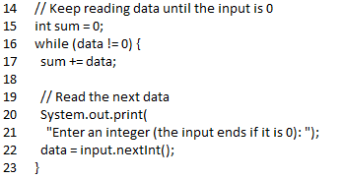
Ending a Loop with a Sentinel Value
Often the number of times a loop is executed is not predetermined. You may use an input value to signify the end of the loop. Such a value is known as a sentinel value.

Slide 46
do-while Loop
do {
// Loop body;
Statement(s);
} while (loop-continuation-condition);

Slide 47
for Loops
for (initial-action; loop-continuation-condition; action-after-each-iteration) {
// loop body;
Statement(s);
}
int i;
for (i = 0; i < 100; i++) {
System.out.println("Welcome to Java!");
}

Slide 48
Trace for Loop
animation
Declare i
int i;
for (i = 0; i < 2; i++) {
System.out.println("Welcome to Java!");
}

Slide 49
Trace for Loop, cont.
animation
Execute initializer
i is now 0
int i;
for (i = 0; i < 2; i++) {
System.out.println("Welcome to Java!");
}

Slide 50
Trace for Loop, cont.
animation
(i < 2) is true
since i is 0
int i;
for (i = 0; i < 2; i++) {
System.out.println( "Welcome to Java!");
}

Slide 51
Trace for Loop, cont.
animation
Print Welcome to Java
int i;
for (i = 0; i < 2; i++) {
System.out.println("Welcome to Java!");
}

Slide 52
Trace for Loop, cont.
animation
int i;
for (i = 0; i < 2; i++) {
System.out.println("Welcome to Java!");
}
Execute adjustment statement
i now is 1

Slide 53
Trace for Loop, cont.
animation
(i < 2) is still true
since i is 1
int i;
for (i = 0; i < 2; i++) {
System.out.println("Welcome to Java!");
}

Slide 54
Trace for Loop, cont.
animation
Print Welcome to Java
int i;
for (i = 0; i < 2; i++) {
System.out.println("Welcome to Java!");
}

Slide 55
Trace for Loop, cont.
animation
int i;
for (i = 0; i < 2; i++) {
System.out.println("Welcome to Java!");
}
Execute adjustment statement
i now is 2

Slide 56
Trace for Loop, cont.
animation
(i < 2) is false
since i is 2
int i;
for (i = 0; i < 2; i++) {
System.out.println("Welcome to Java!");
}

Slide 57
Trace for Loop, cont.
animation
Exit the loop. Execute the next statement after the loop
int i;
for (i = 0; i < 2; i++) {
System.out.println("Welcome to Java!");
}

Slide 58
Which Loop to Use?
The three forms of loop statements, while, do-while, and for, are expressively equivalent; that is, you can write a loop in any of these three forms. For example, a while loop in (a) in the following figure can always be converted into the following for loop in (b):
A for loop in (a) in the following figure can generally be converted into the following while loop in (b) except in certain special cases (see Review Question 3.19 for one of them):

Slide 59
Recommendations
Use the one that is most intuitive and comfortable for you. In general, a for loop may be used if the number of repetitions is known, as, for example, when you need to print a message 100 times. A while loop may be used if the number of repetitions is not known, as in the case of reading the numbers until the input is 0. A do-while loop can be used to replace a while loop if the loop body has to be executed before testing the continuation condition.

Slide 60
Exercise 2(b)

Slide 61
Casting
Java allows us to convert values of primitive types as well as reference types.
Our focus today will be on converting the numerical primitive types.
We’ll return to the notion of type-casting after we go over one of the major topics of the semester: Inheritance.

Slide 62
Casting
Before going forward, understand that java implicitly casts in certain situations.
For example,
double x = 5 * 4.0;
What is happening here? When performing the calculation, java will convert 5 to 5.0 beforehand.

Slide 63
Casting
We can always store a value of a smaller-range type in a variable of a larger-range type.
For instance,
double x = 5;
On the other hand, the opposite is not true.
int x = 5.5;
What happens here? This results in a compiler error as we cannot possibly store the value 5.5 in an int variable.

Slide 64
Casting
What can be done about this?
We can perform an explicit cast if we want to store the integer portion of that double value.
int x = (int)5.25;
What will be stored in x?

Slide 65
Casting
The generic syntax will be as follows,
type varName = (type) value;

Slide 66
Assignment #2

Slide 67
Lab #2

